Slide 1

National Dredging Quality Management (DQM) Program
Midwest Weda Chapter
26 APR 2012
Vern Gwin
Director, National DQM Center

Slide 2
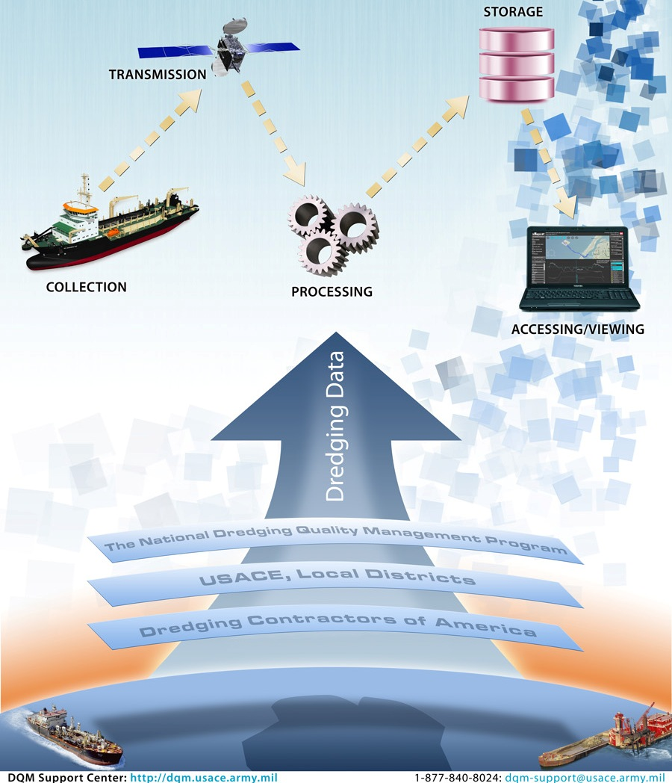
Program Status
Advancements
Future

Slide 3
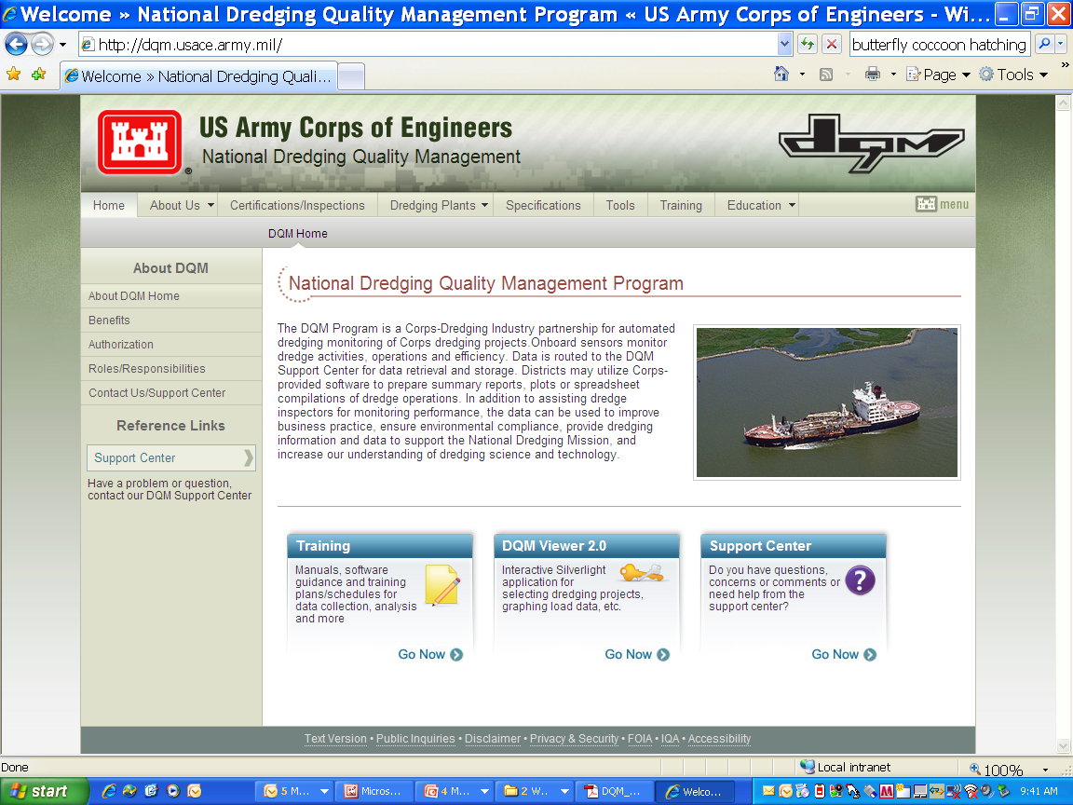
New DQM Website
Notes:
The new DQM website was launch earlier this year. The DQM program has gone totally web based. This website replaces the old SI site and serves as the foundation for everything that is DQM……the latest specifications, contact information, links to the new V2.0 tools and tutorials for new users.

Slide 4
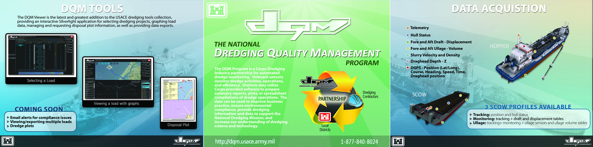
Annual Goals
Integrate Customer input in tool scoping
Improve the Timeliness of the Data
Improve Customer Support
Improve the Dependability of the System
Improve Partnership with Industry
Improve Quality of the data
Notes:
Every year the DQM Center lays out its annual goals and objectives. In general, these goals are dynamic and will continue to reflect the philosophy of the National DQM Center.

Slide 5
Program Advancements
-All Web Based Environment: Tools, Website
-State of the Art Oracle Database
-Near Real-time Telemetry from Hoppers
-Improved Specs: Measurable Increase in Data Quality, Reduced Inspection Time
-Partnerships: Industry, Districts, EPA, BOEMRE
Notes:
The technological advancements reflect the goals and objects of the program to improve timeliness, dependability, and quality of data for the Corps dredging manager. Industry has stepped to the plate with the challenge of meeting our new specification requirements such as near-real time data transmission from the hoppers, in addition to new on-board software installation.

Slide 6
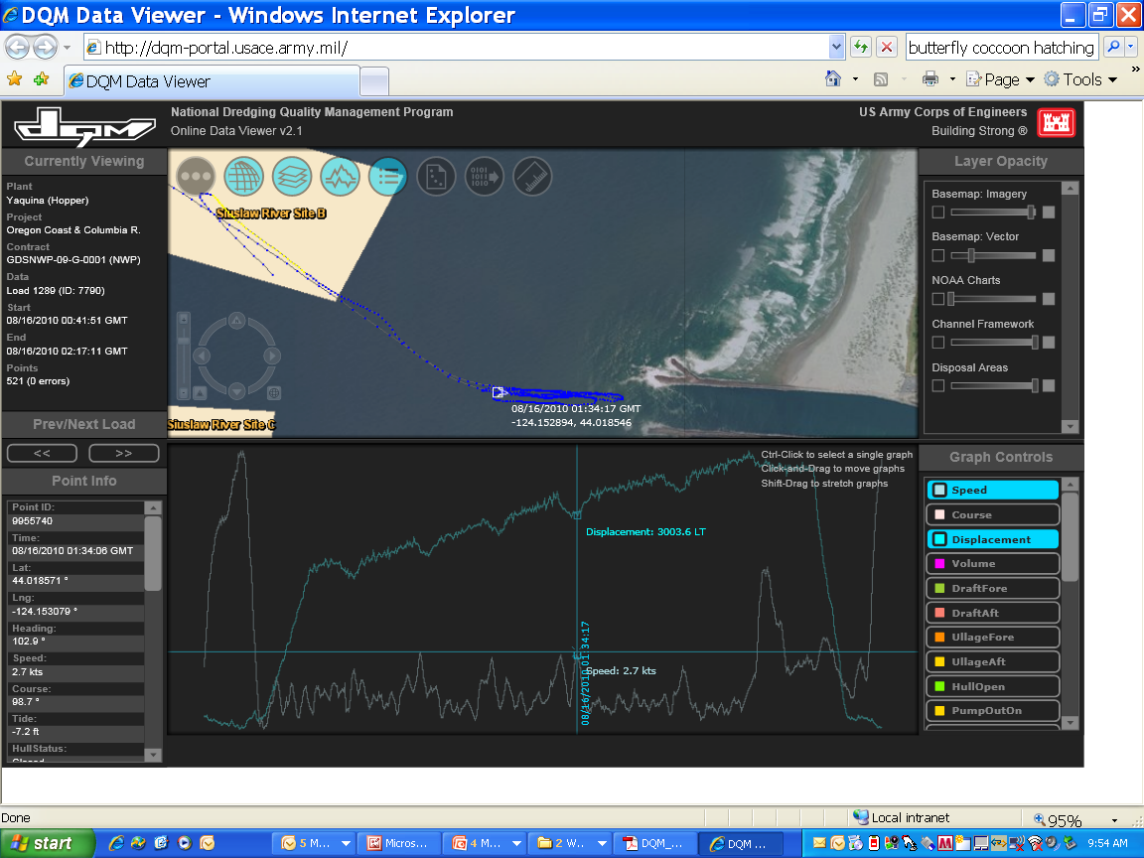
Notes:
The new DQM V2.0 tools were launch in the Fall of 2010. Since the Fall launch, the DQM team has met and provided basic training on the new tools to all coastal Corps districts. This summer, the DQM team will be meeting with the Great Lakes Districts to provide training and gain feedback on the tools. The initial reaction from the Corps District’s has been overwhelmingly positive. Feedback has been extremely constructive and is currently the basis for ongoing development and improvement efforts for future versions.

Slide 7
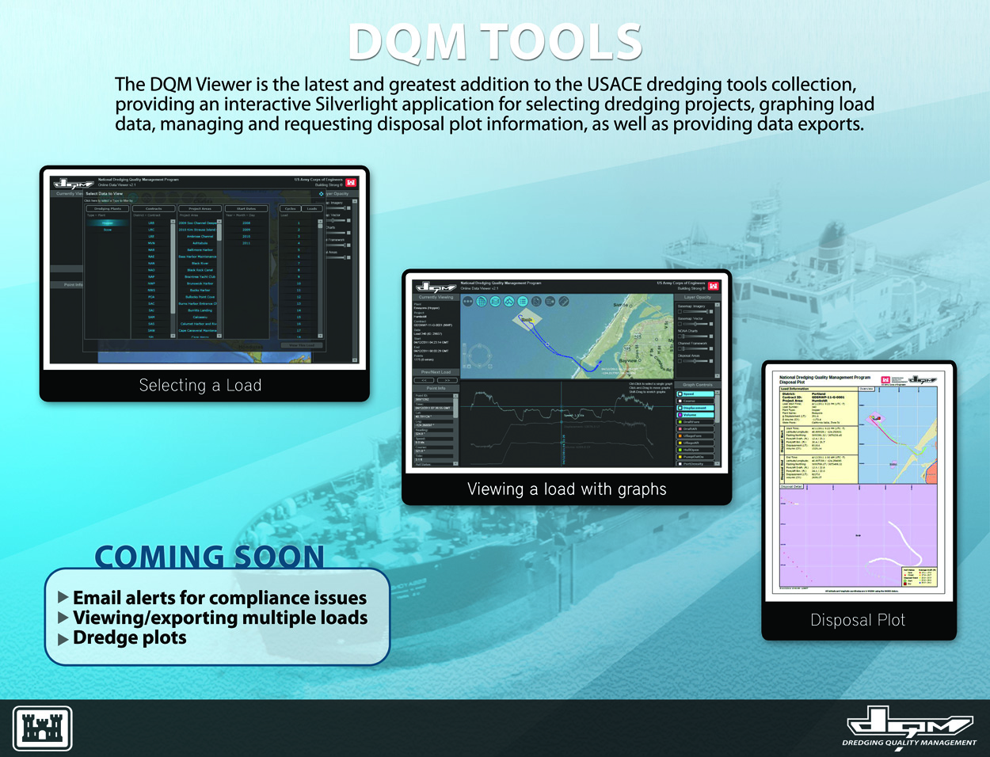
Notes:
The V2.0 tools utilize the latest web technology to provide the Corps’ dredging managers with timely, dependable, user friendly tools, such as the viewer, dredging plots, and data export capability.

Slide 8
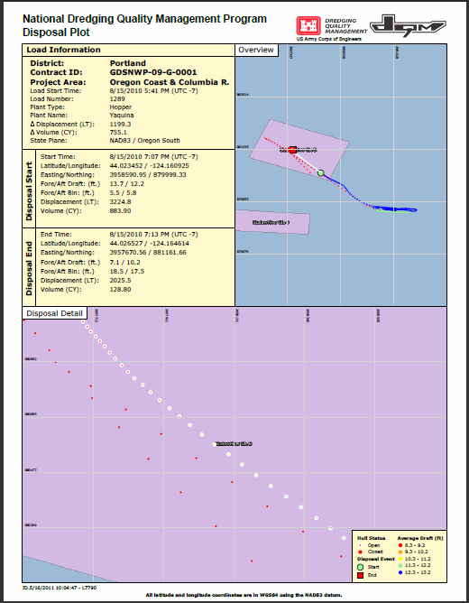
V2.0 Disposal Plot
Notes:
This is a screen shot example of the web generated disposal plots from the V2.0 tools. It contains summary information regarding the load such as start and end time of the load, estimated volume, and vessel displacement.

Slide 9
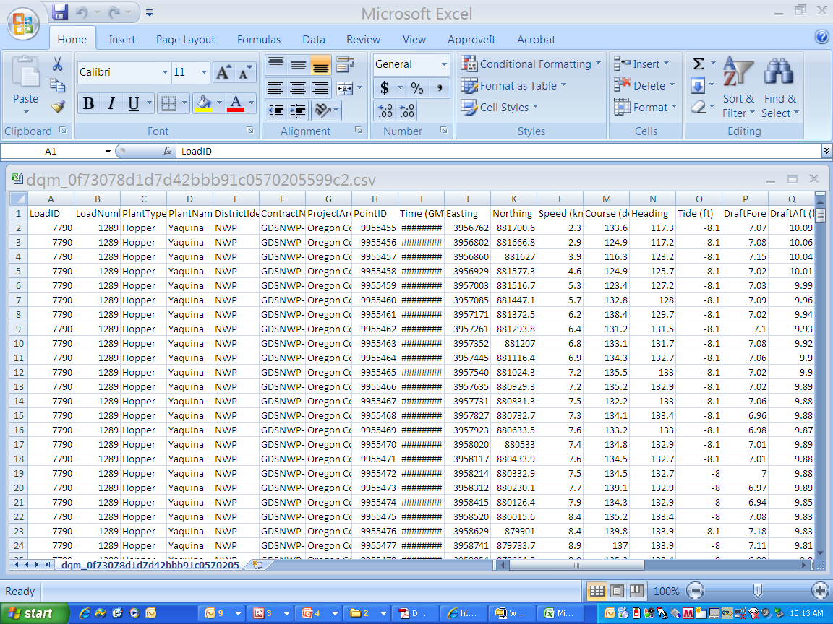
DQM Data Export
Notes:
This is a screen shot of the exported data from the V2.0 tools. This export contains all parameters measured for the selected load and every data point collected.

Slide 10
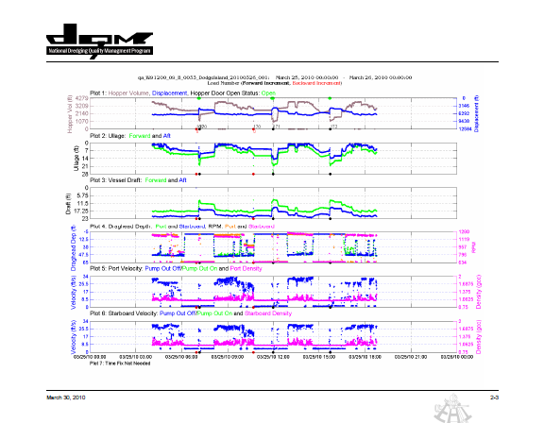
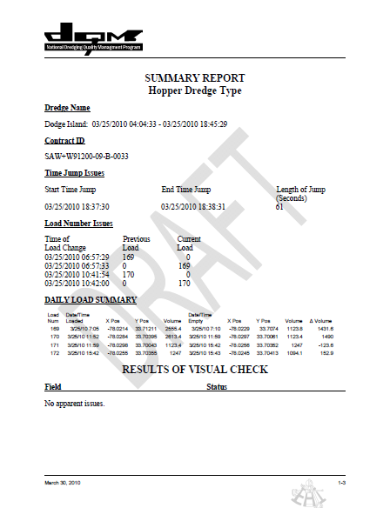
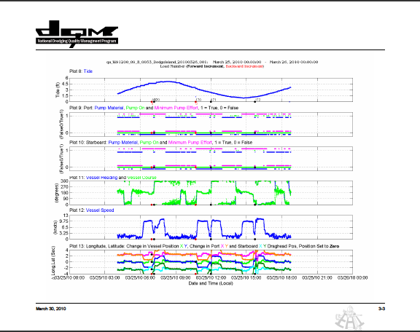
Data QA so we can…
Notes:
Our new Matlab development has resulted in much improved QA data review capability. While this tool was developed for internal QA analysis for the DQM center, many District offices have begun requesting this tool for their own QA needs.

Slide 11
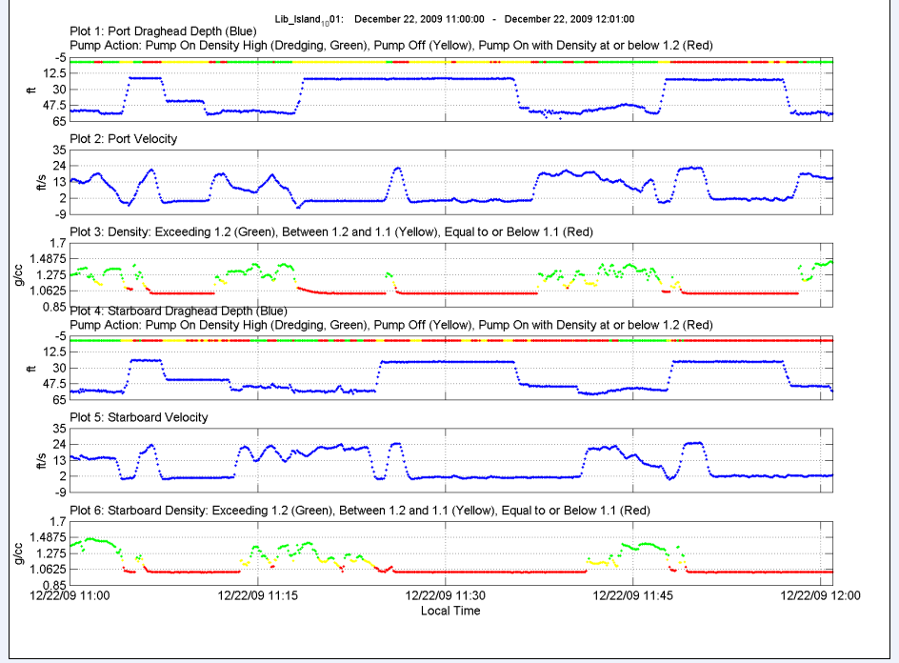
Notes:
The Turtle reports generated from the Matlab program have been used quite often in the Mayport job in the Jacksonville District. The Center is receiving very positive feedback on the usefulness of this data to better understand the conditions of the dredge during when a turtle is taken, resulting in more understanding and confidence in continuing dredging operations in lieu of shutting down operations.

Slide 12
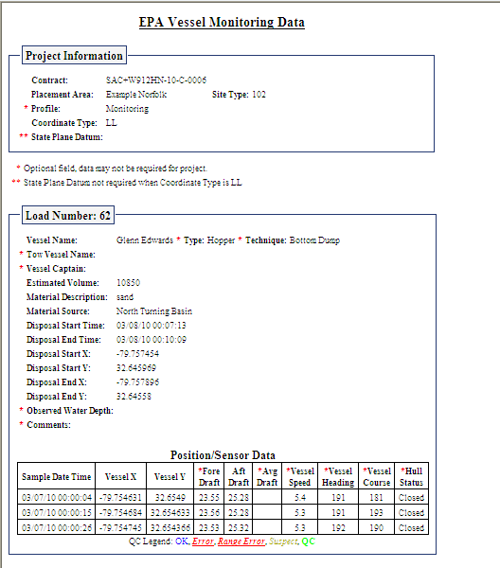
Standardized EPA Reporting
Notes:
Another advancement over the last year has been a joint effort with EPA region 4 to standardize the EPA dredging data reporting requirements for the SAD Districts. This development has resulted in reducing the burden on the Districts and contractors to develop this individually and has help standardize the process. The two dredge monitoring systems; although significantly different in design actually complement each other, helping both agencies meet specific needs and uses. In addition to assisting USACE Districts for environmental compliance, the data can be used by the USACE to improve business practice, monitoring performance, and provide dredging information and data to support the National Dredging Mission.

Slide 13
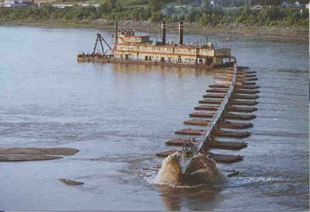
HQ’s Directive
Cutterhead Monitoring
National PDT
Industry Coordination
Implementation Plan
Initiate on a small scale
Phased approach

Slide 14
Future Extreme
V2.5 – Matlab Cycle Analysis, Dredge State
  EPA and BOEMRE Reports web accessed
  GIS Integration
  Turtle Plots web accessed
QA reports web accessed
National DQM Technical Advisory Team
  Address need for Additional Parameters, Specs
  Work with Industry on Tech Issues
  Develop Scope for next Generation Tools

Slide 15
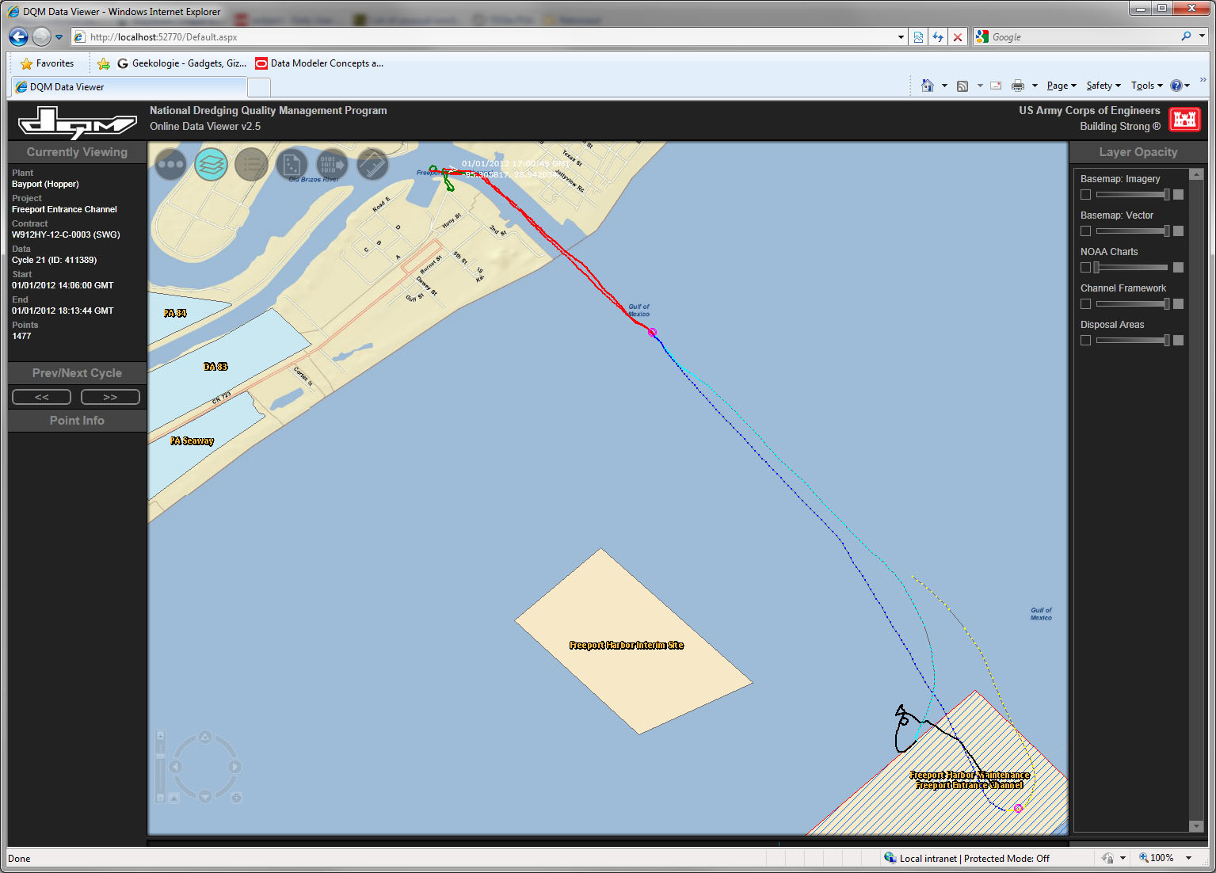

Slide 16
Future ( )
2
V3.0 Dredging Analysis Tool
  Multiple Load Disposal Plots
  Email Alerts
  Multiple Load Export Capability
  Customized Export Capability
  Dredge Plots
  Internal Database improvements
Near-Real Time Scow Data
Pipeline Evaluation

Slide 17
