Slide 1

Annual Meeting
21 to 23 October 2025
Honolulu, HI

Slide 2
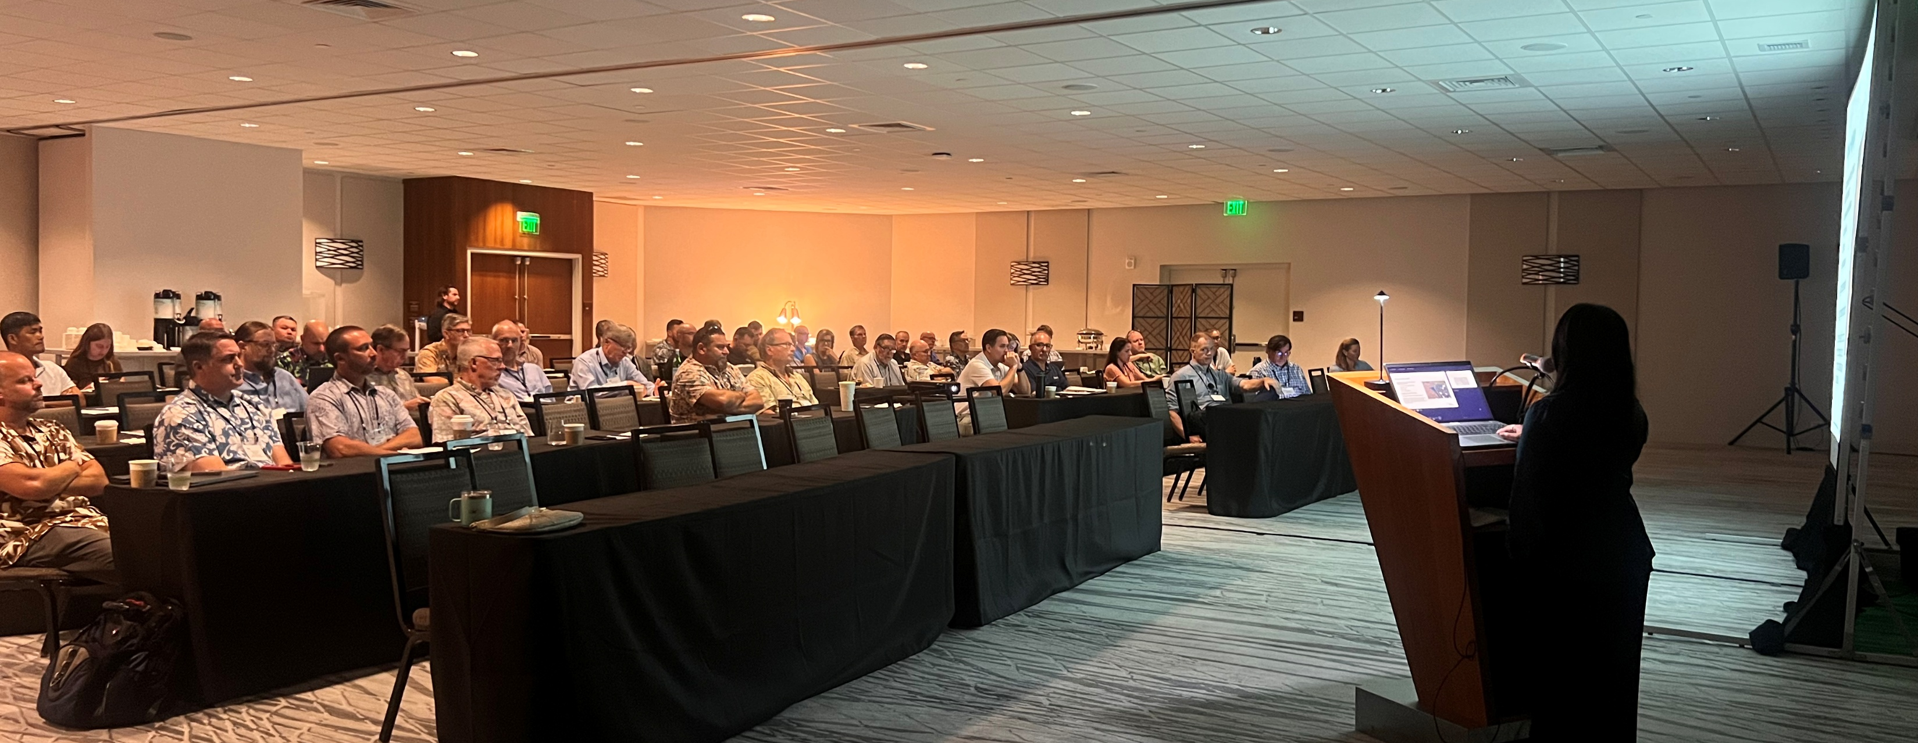
Post-Conference Recap
(President’s Report)

Slide 3

Upcoming WEDA Meetings
2026 Dredging Summit & EXPO
Montreal, Quebec, Canada
Hotel Bonaventure Montreal
July 20-23, 2026

Slide 4

Thank you to our Sponsors!

Slide 5
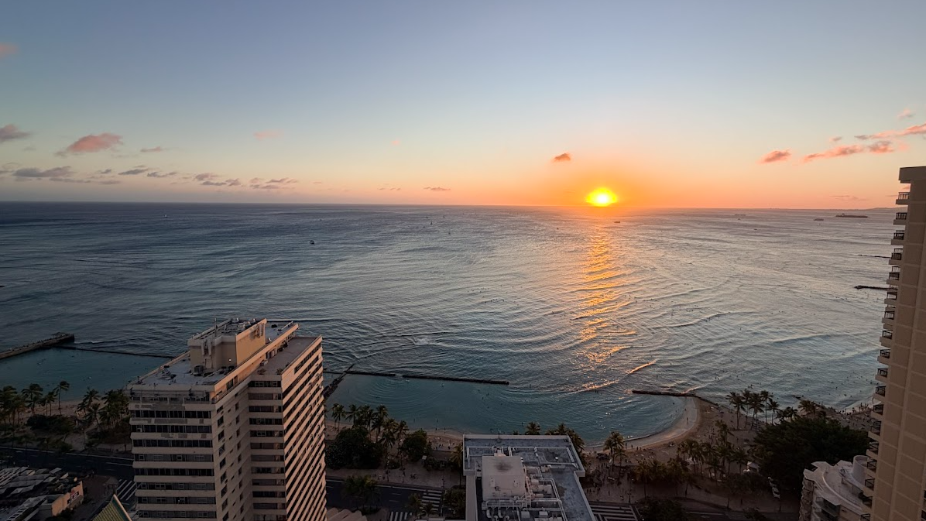
2025 Wrap-Up
Registrants: 67
Mai thai’s consumed: 1,045,069
Meeting Cost: $75,340
Sponsorships: $10,500
Registration income: $32,754
Meeting Cost – Total Income: -$32,086
Networking and talking about dredging in this beautiful location: PRICELESS!

Slide 6
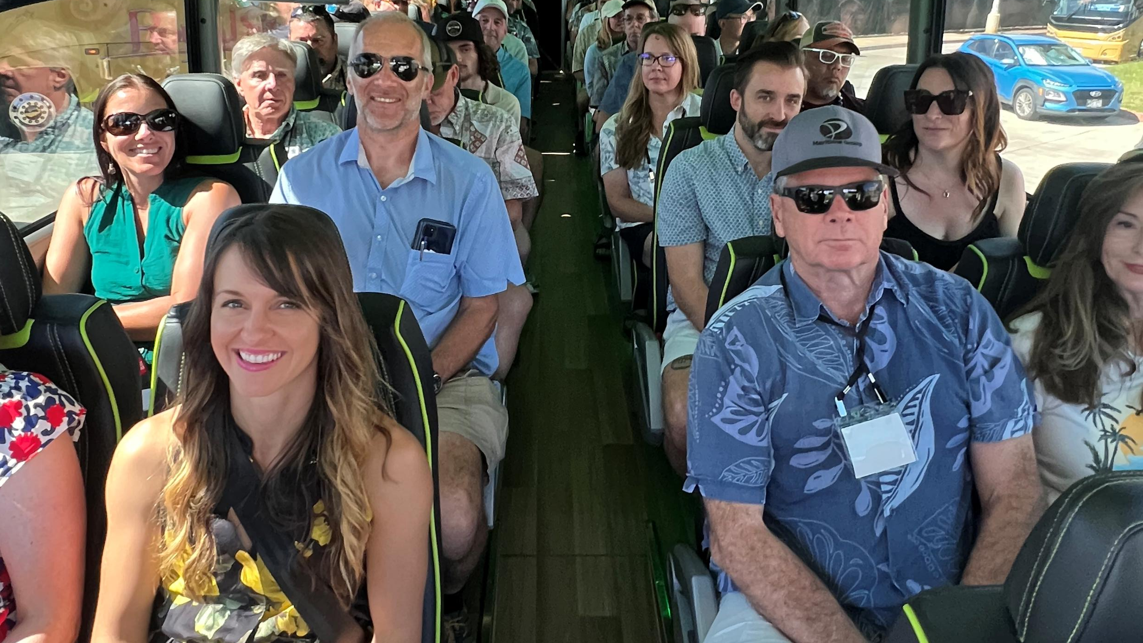
BY the Numbers
2025 Attendees: 67
(down 93 from last year)

Slide 7
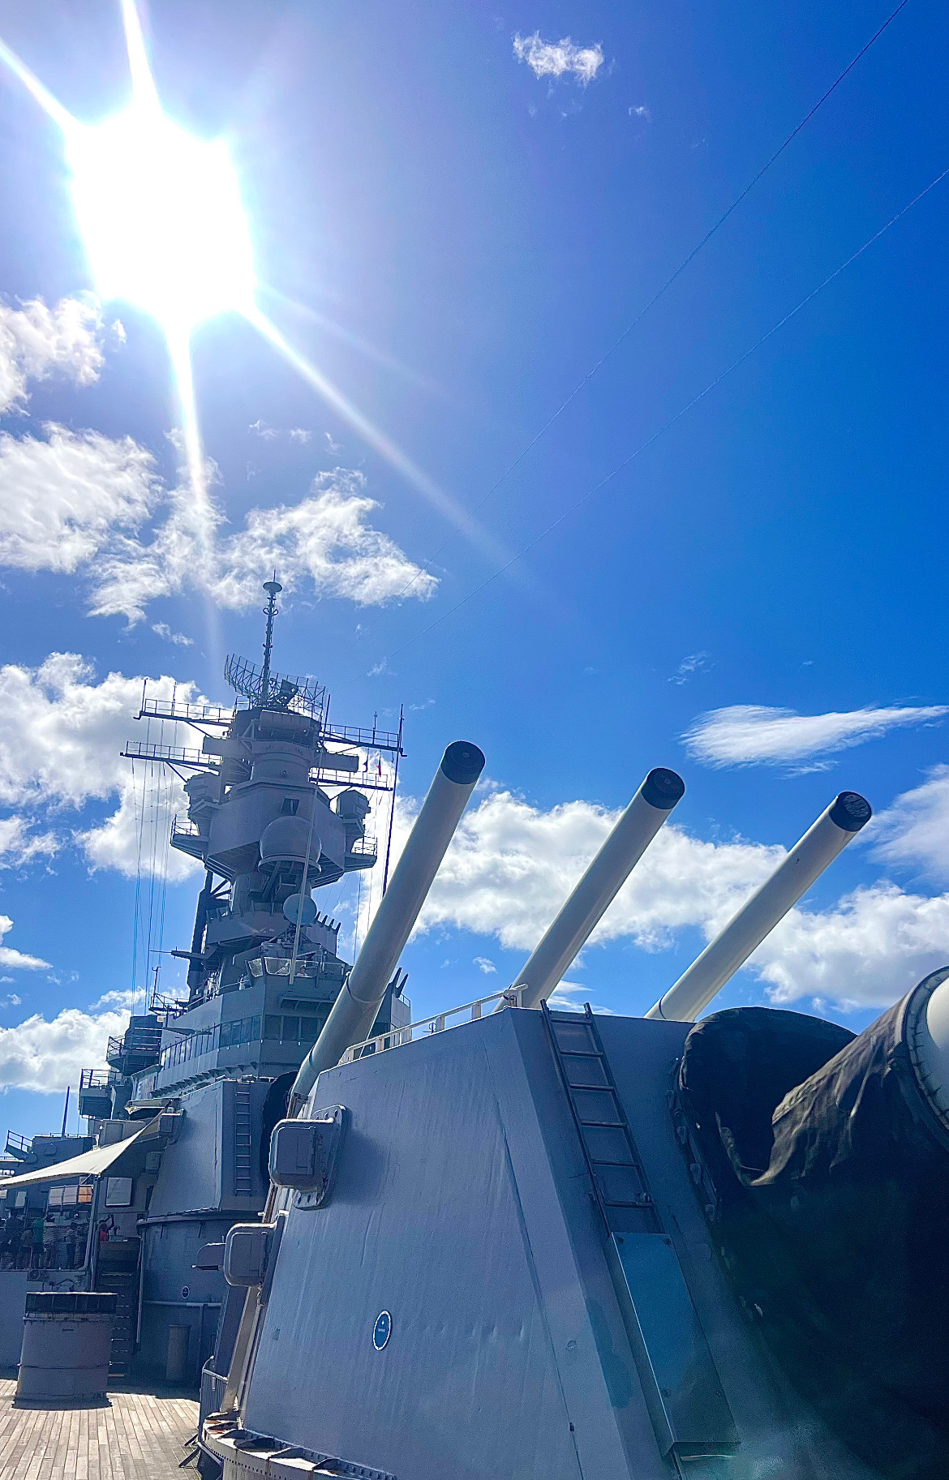
NEW BOARD MEMBER APPLICATIONS
The goal is to achieve a diverse board that represents the membership. Effort are made to include a mix of contractors, US Army Corps of Engineers (Corps), consultants, Ports, academics, and other agencies. Chapter board members are to serve on the board for three (3) to six (8) years.
We are now accepting applications!

Slide 8
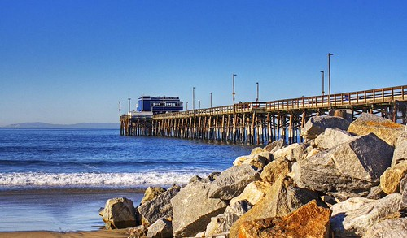
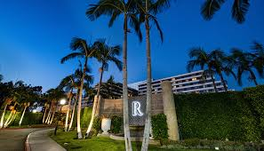
2025 Meeting
October 20 – 22, 2026
Newport Beach, CA
Renaissance Hotel
4500 MacArthur Blvd, Newport Beach, CA 92660

Slide 9
SEE YOU NEXT YEAR!!!
On Behalf of the Entire WEDA Pacific Chapter Board
THANK YOU!

